Slide 1

Bugle
Making a Difference Just Got Easier!
Team: Sachin Kumar, Sumit Srivastava, Pooja Gosavi, Nida Syed, Lin Zhu,
Shyam Ramakrishnan, Cameron Harris

Slide 2
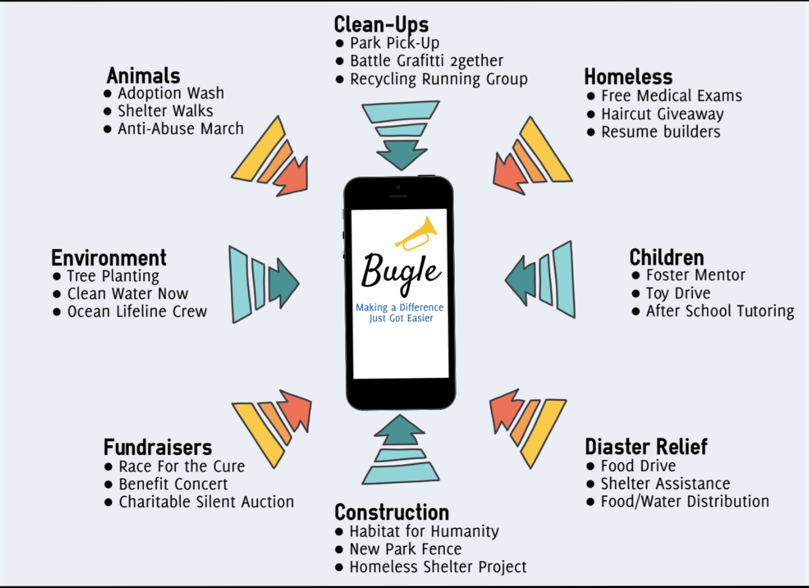
Bugle: Introduction
Notes:
[Nida]:
What it does, what we have done
How it is different from contemporary apps - Chatting func & 3rd party background verification
We have come a long way! Yay bugle!

Slide 3
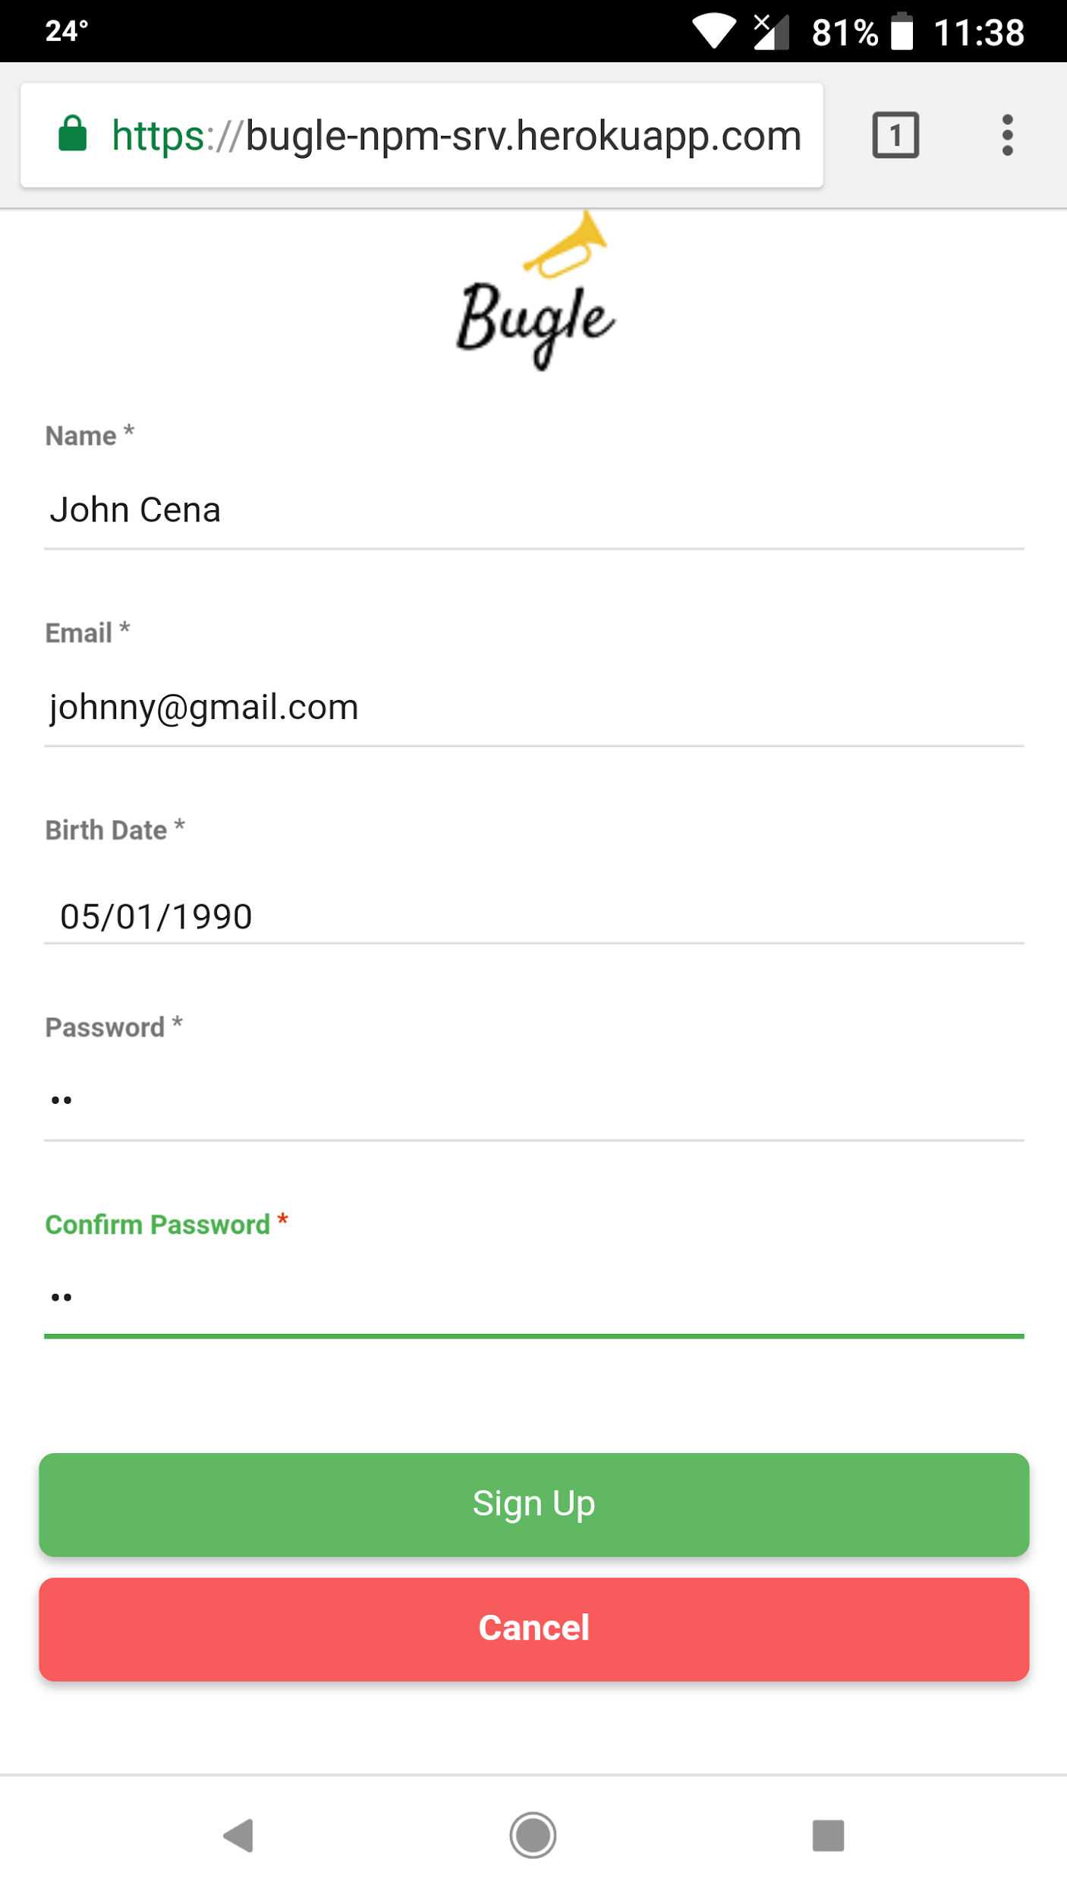
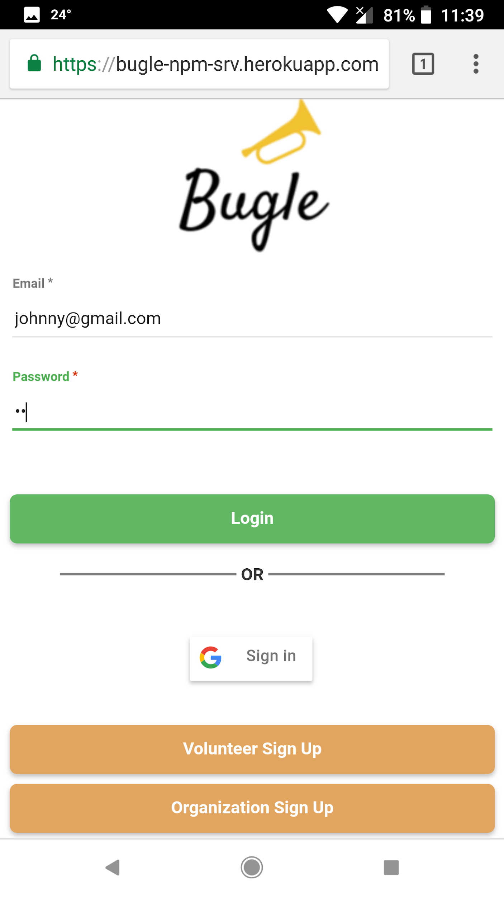
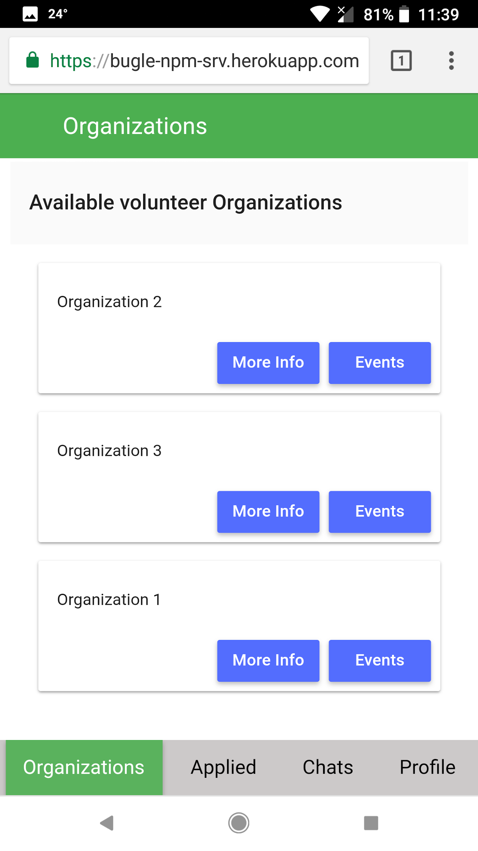
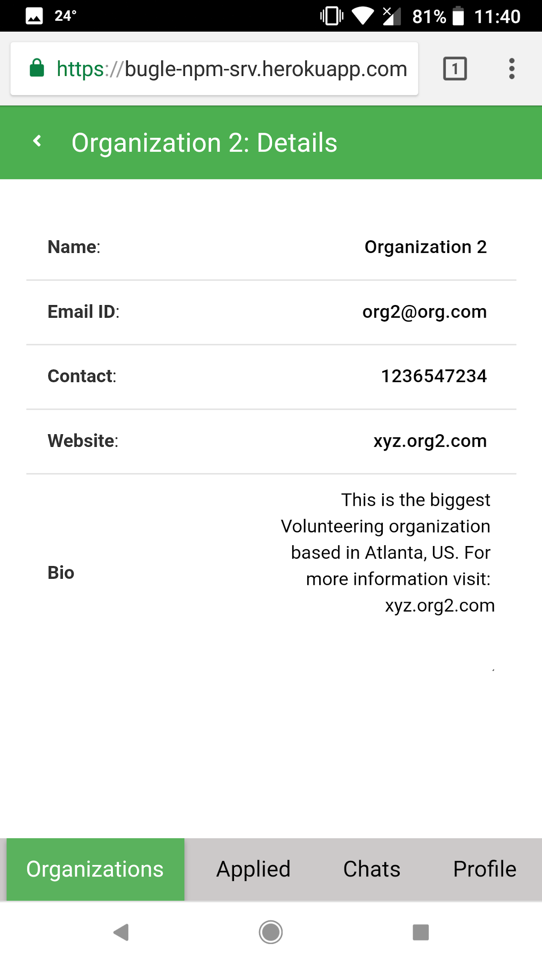
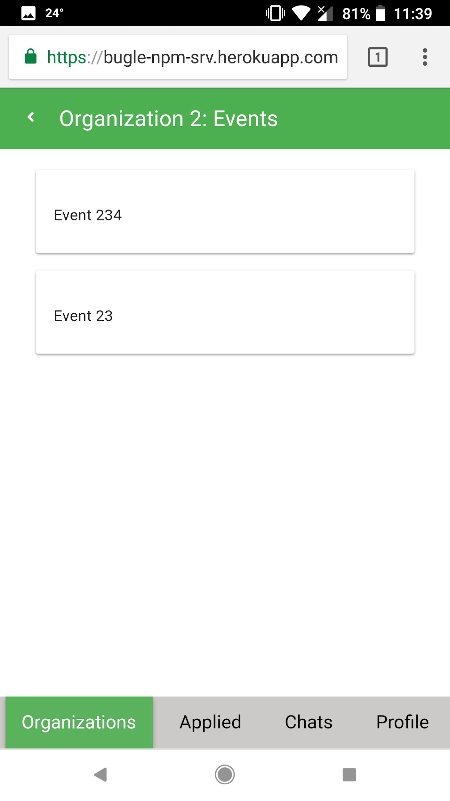
Volunteer Flow
Signup
Login
Home Page
Org Details
Org Events
Notes:
[Sumit]

Slide 4
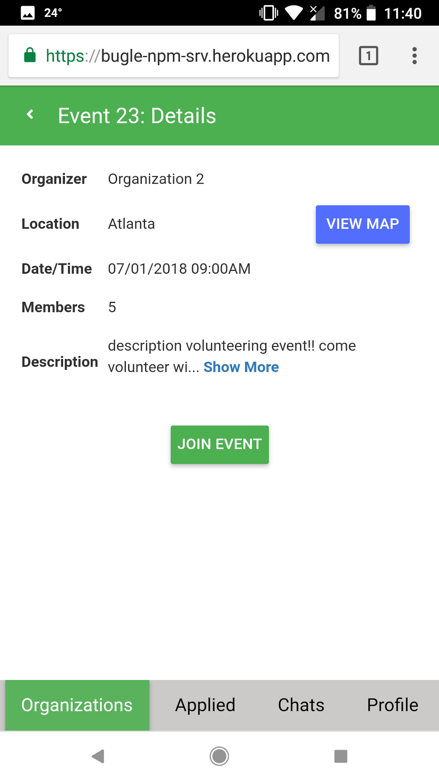
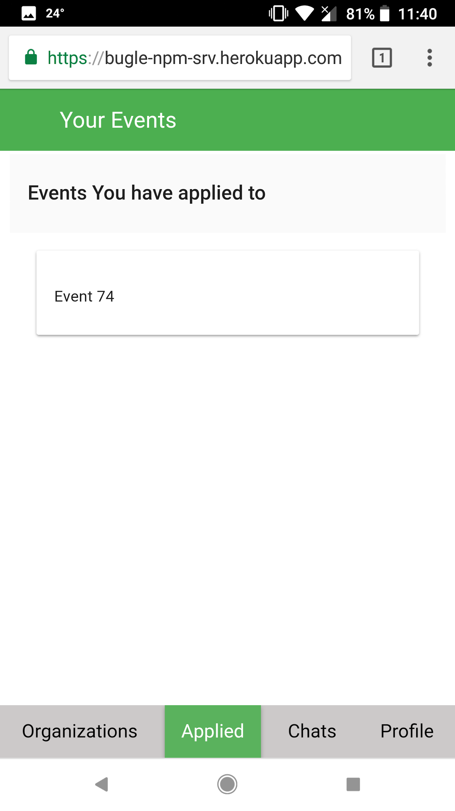
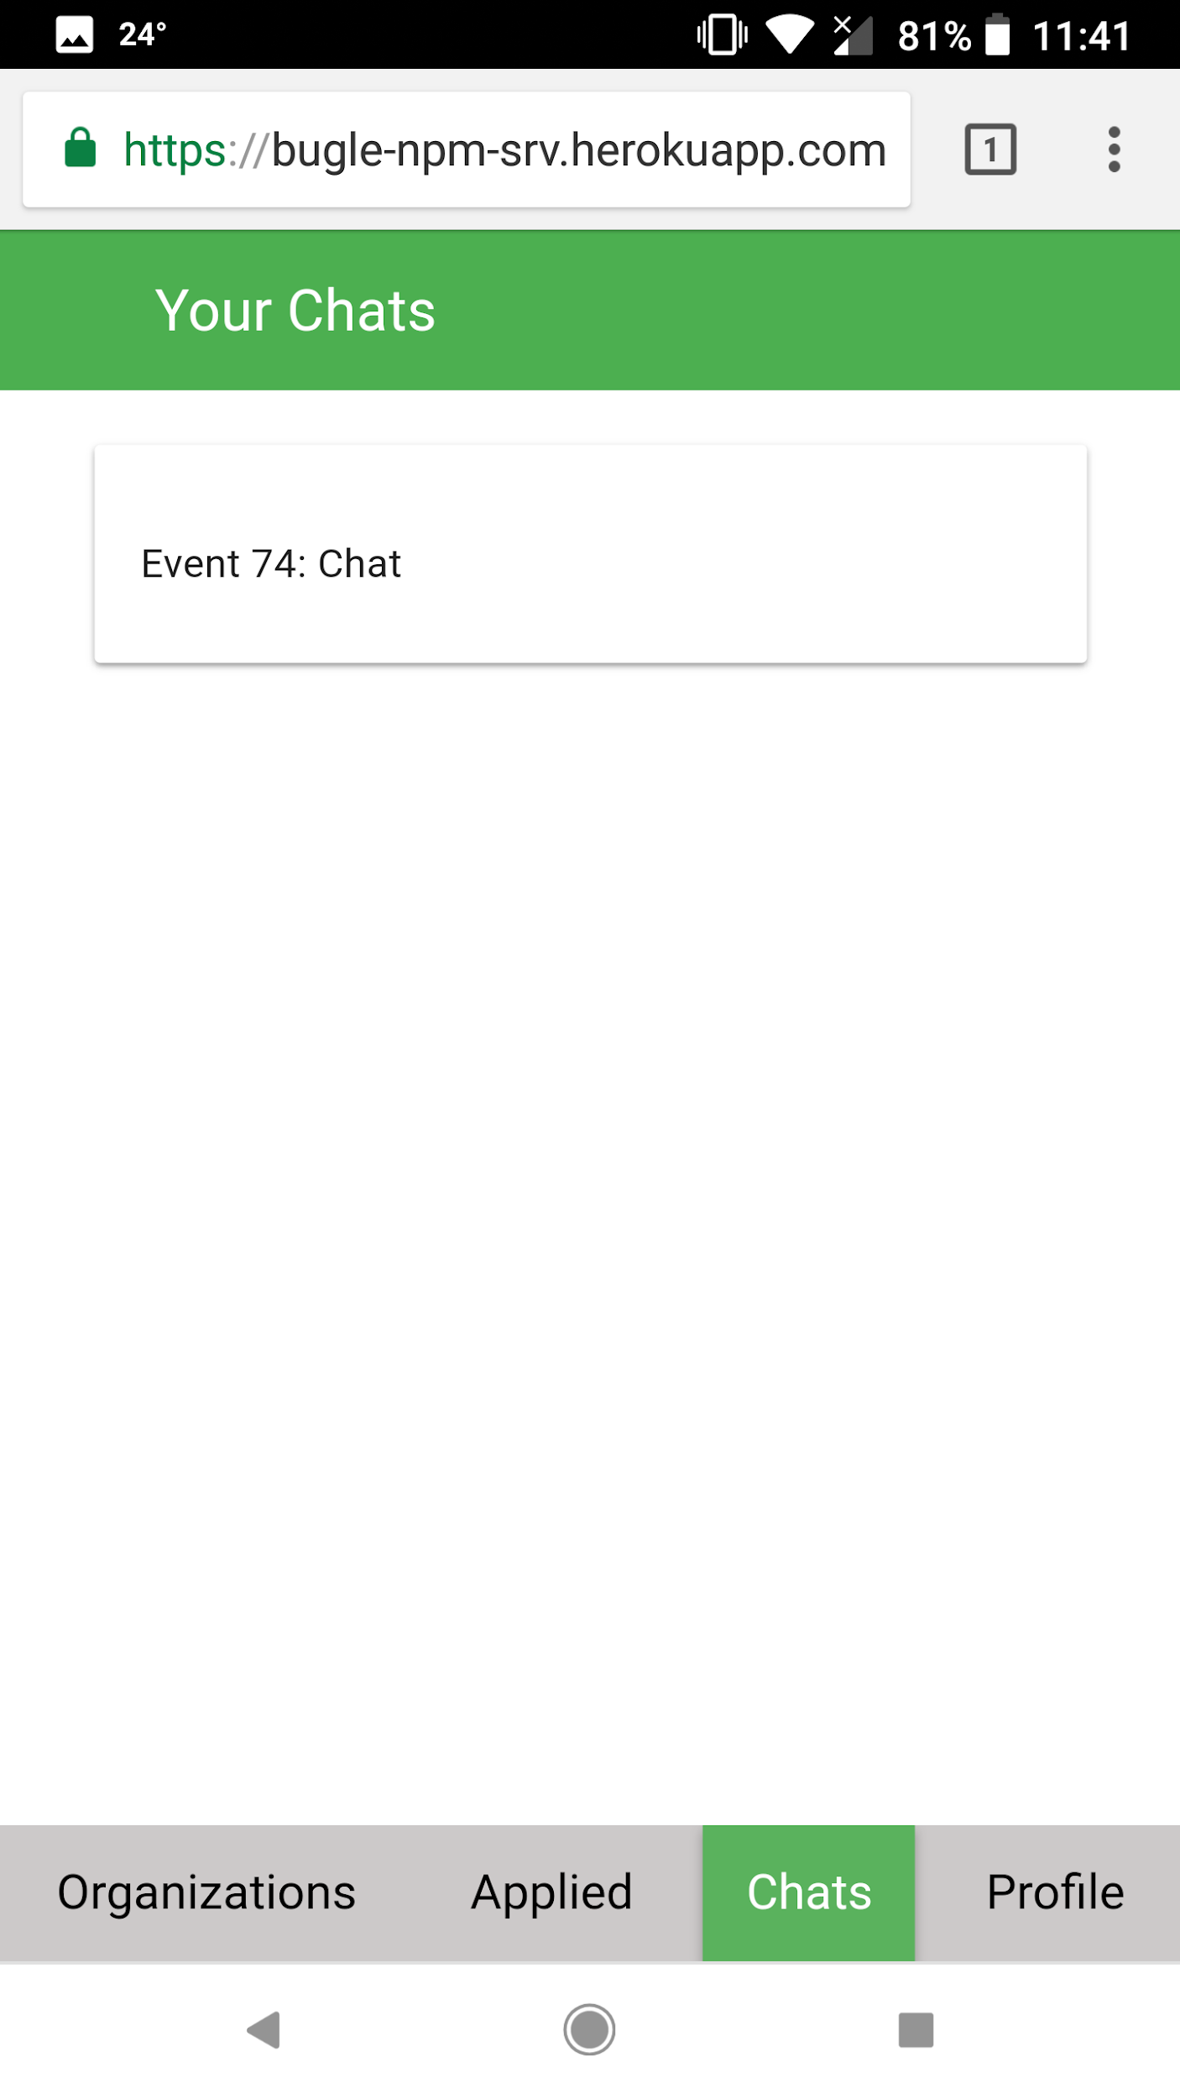
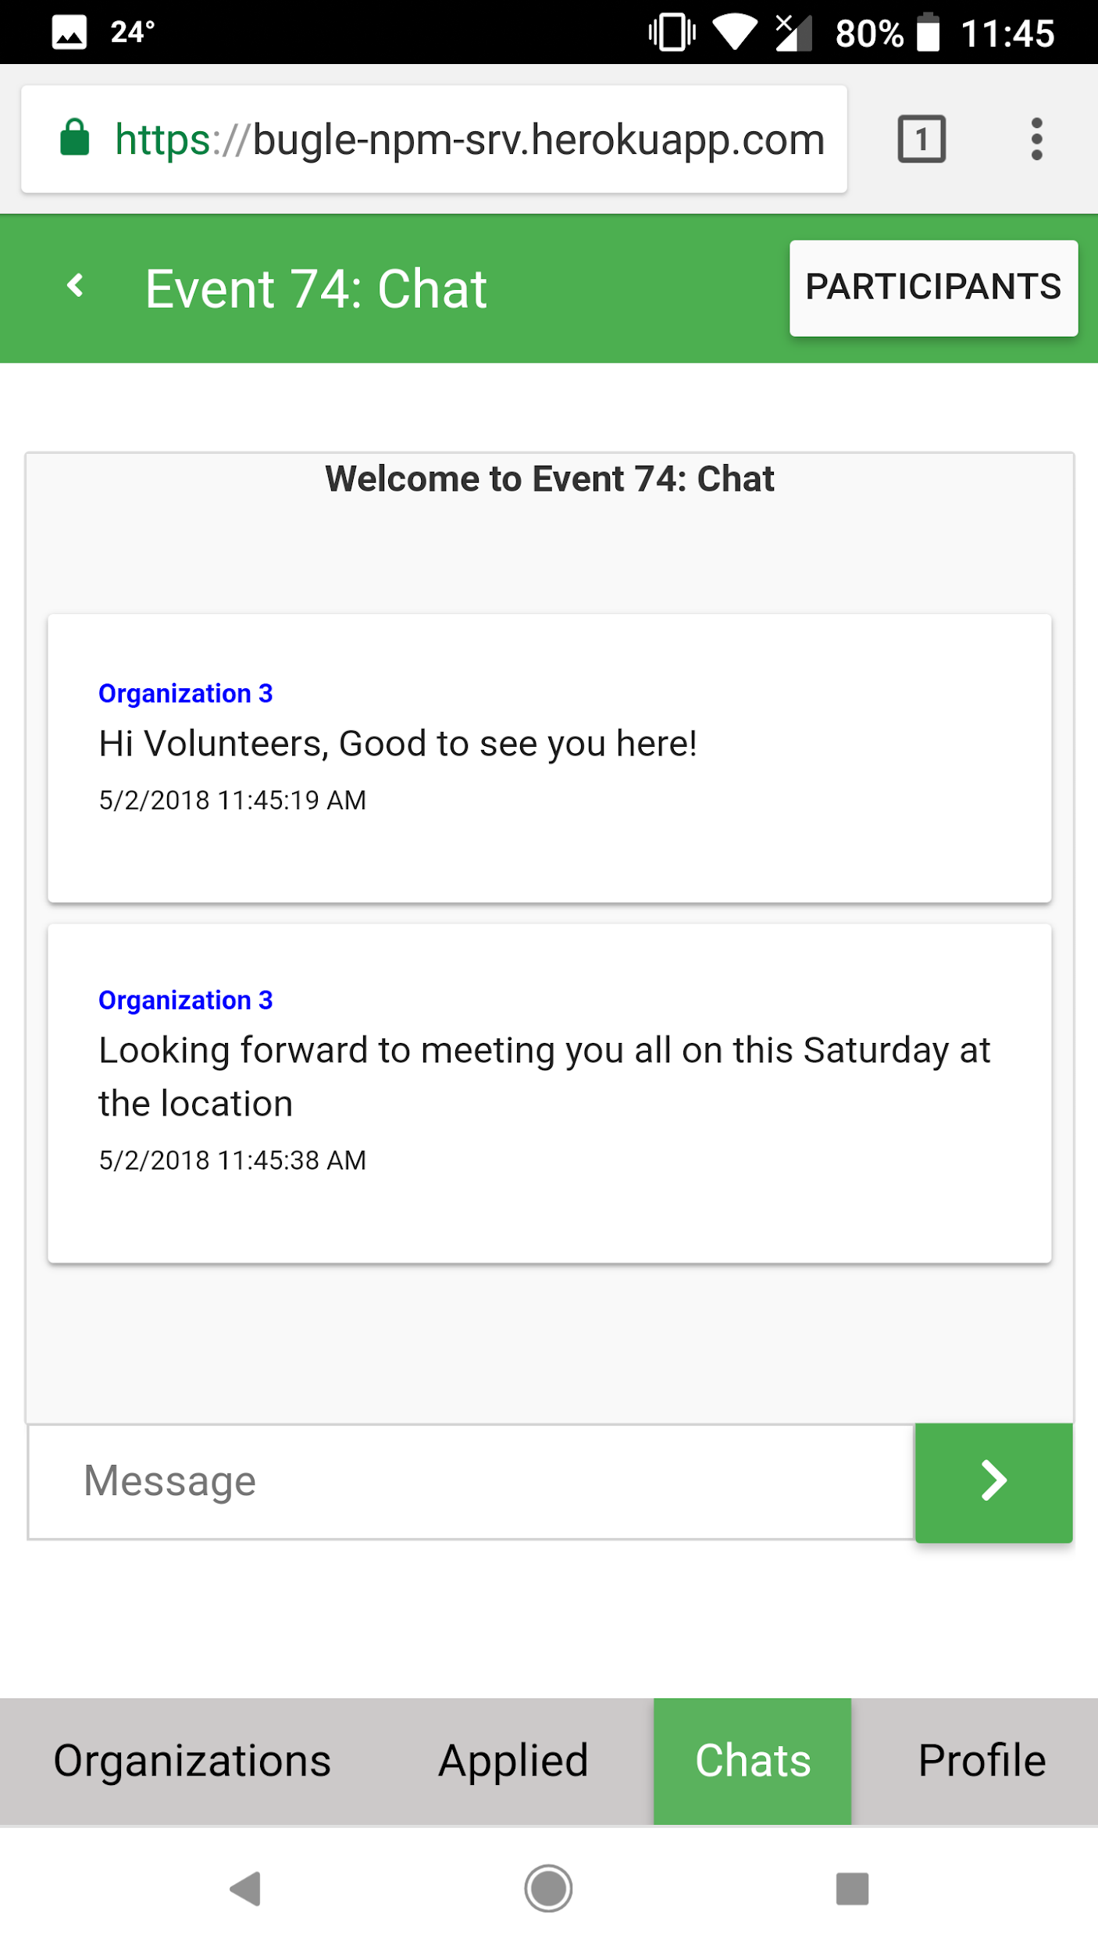
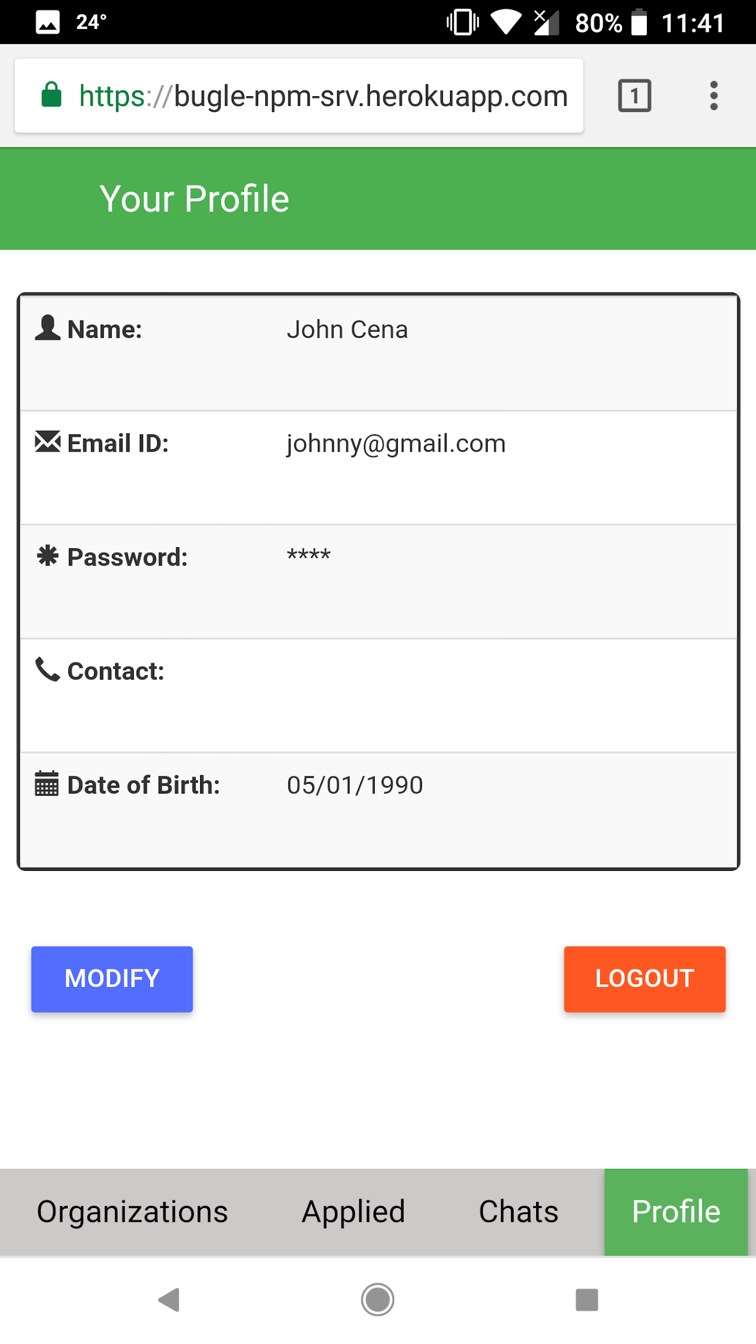
Volunteer Flow
Event Details
Applied Events
Chats
Chat
Profile
Notes:
[Sumit]

Slide 5
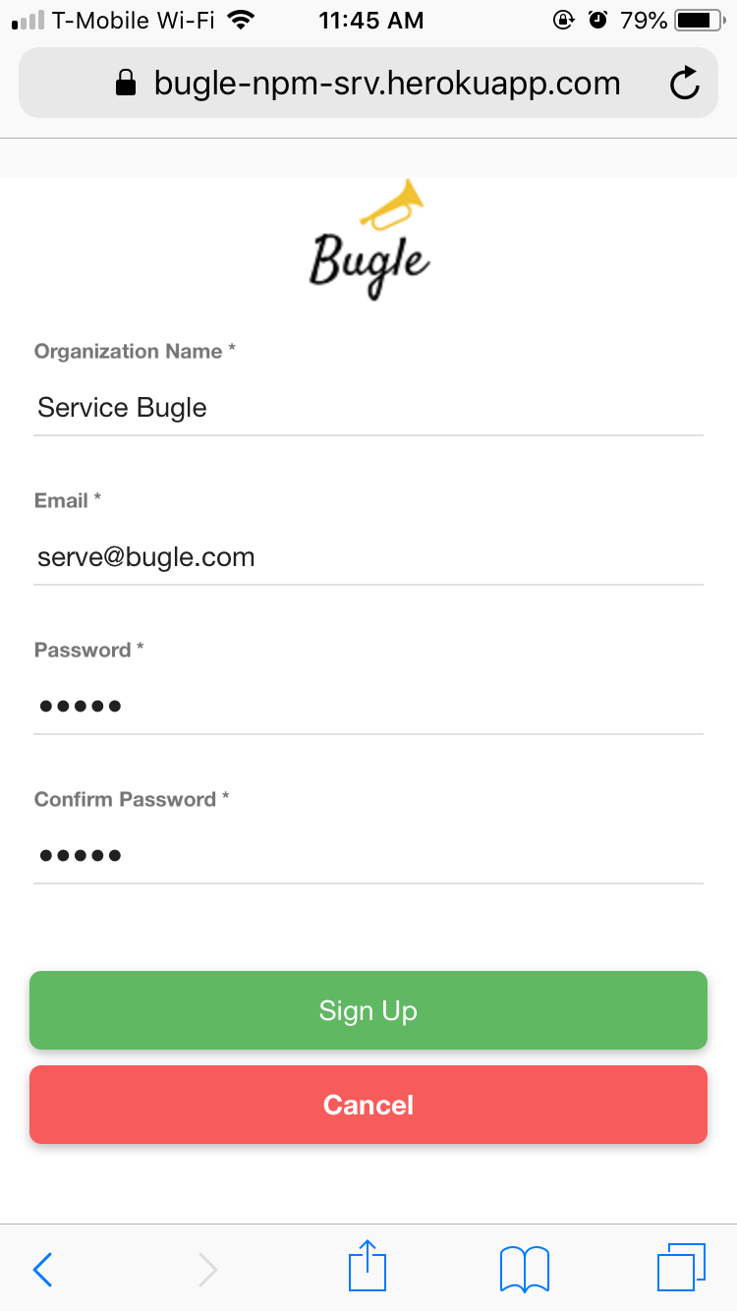
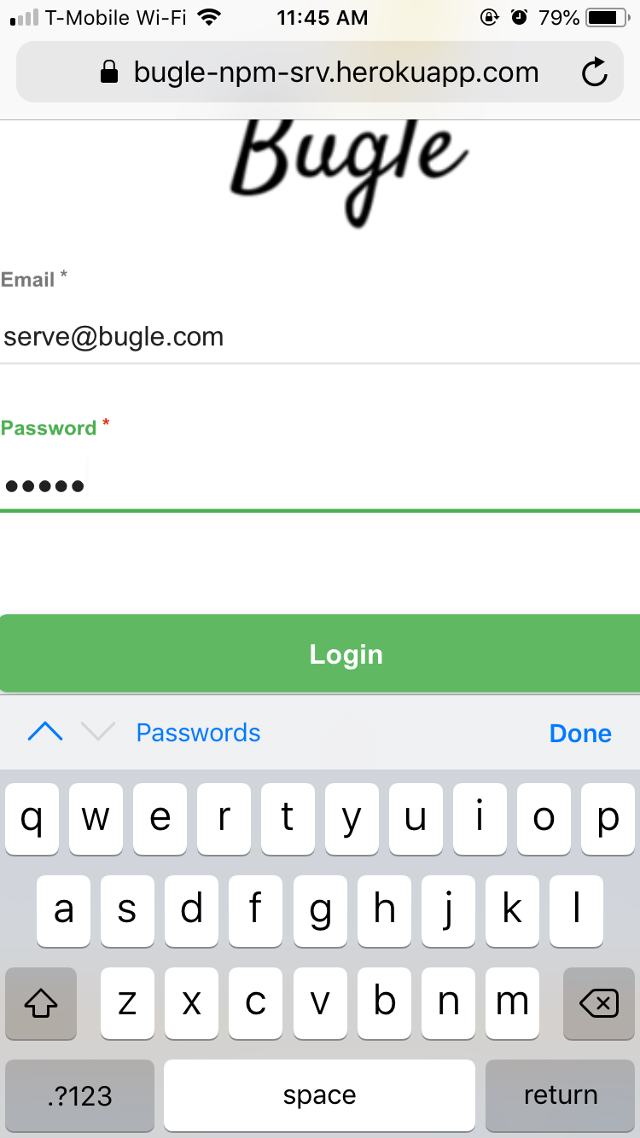
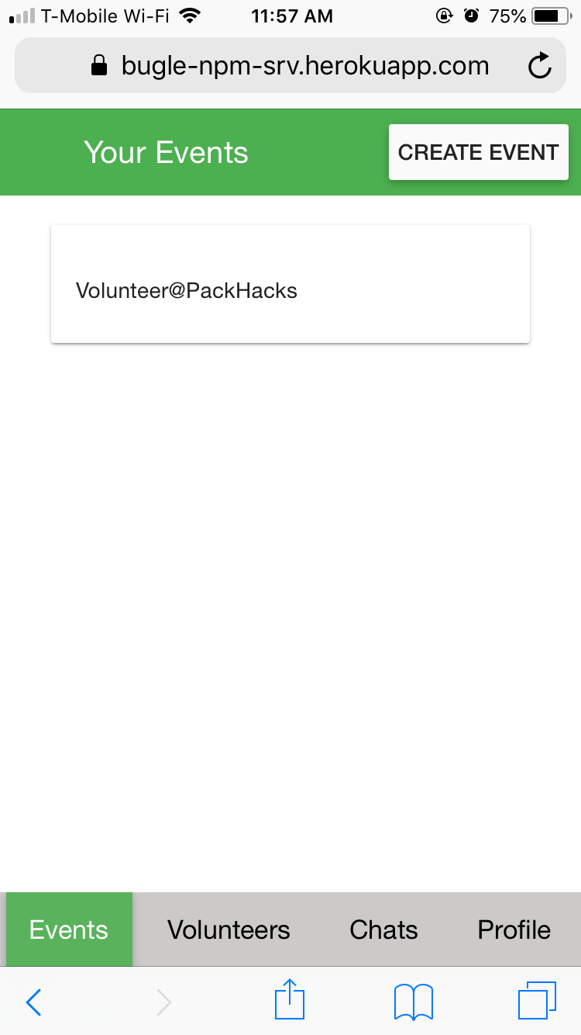
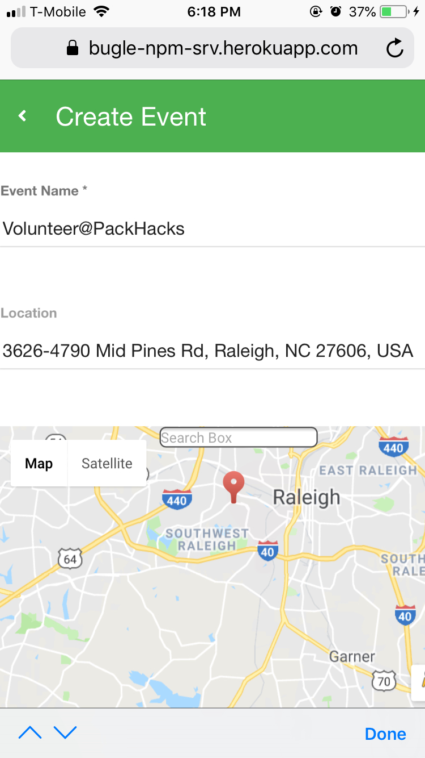
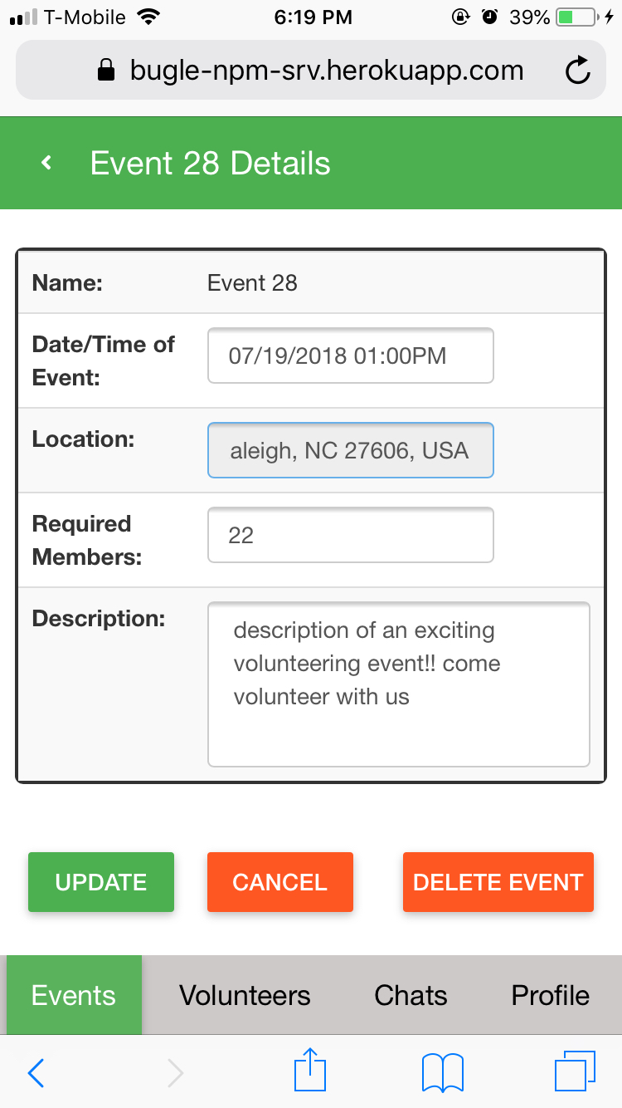
Organization Flow
Signup
Login
Home Page
Create Event
Edit Event
Notes:
[Pooja]

Slide 6
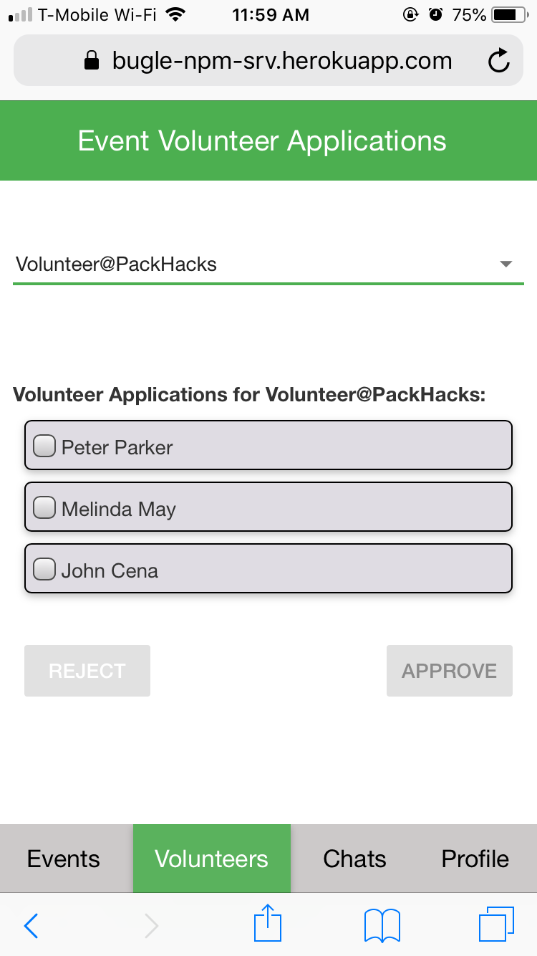
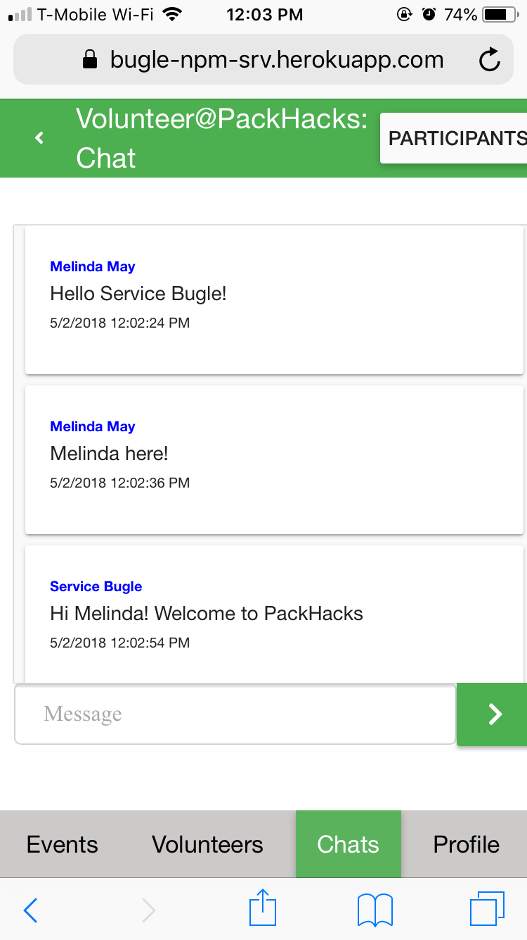
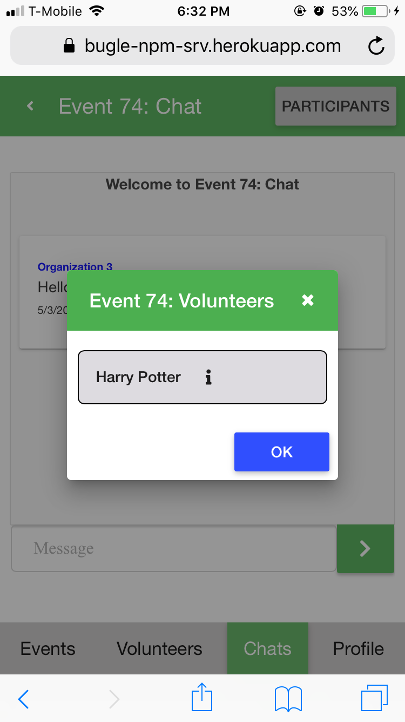
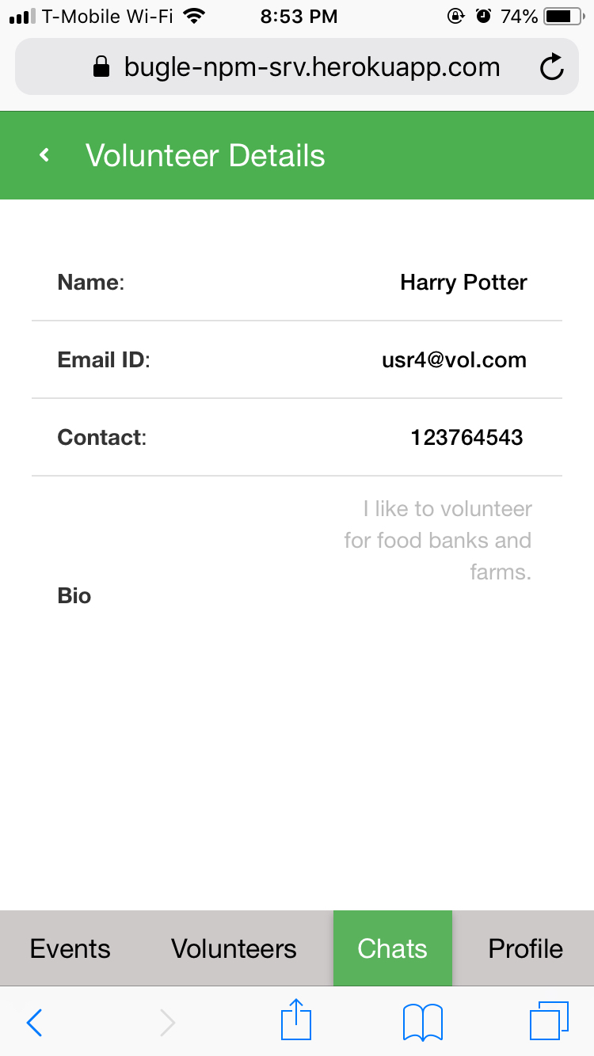
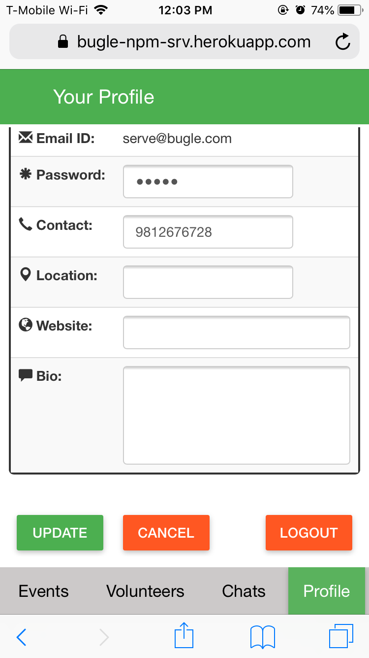
Organization Flow
Volunteer Approval
Organization Chat
View Participants
Volunteer Info
Edit Profile
Notes:
[Pooja]

Slide 7








Bugle: Technology Stack
DB
WebSocket Framework
UI Server
Deployment Server
Backend Server
Google Authentication
Front End
Google Maps API
Notes:
[Shyam]

Slide 8
Challenges we faced
Chat persistence.
Deciding on Database.
Google Maps Integration.
Google Sign in Integration.
Angular Material Design
CORS (Cross Origin Resource Sharing)
Heroku restarting dynos.
Notes:
[Cameron]
MongoDB → Sqlite → PostgreSql
Cross-Origin Resource Sharing: without it, there are security risks

Slide 9
What we accomplished
Mobile website
Google Sign in or Email Signup
Separate modules for Volunteer and Organisation
Organizations can host volunteering events.
Volunteers can view all events and apply.
Organizations can approve or reject volunteer applications
Chat features for organisers and volunteers to interact.
Google Maps integration.
Notes:
[Sachin]

Slide 10
Future work
Profile rating system.
Integration with BeenVerified for background verification.
Option for users to add profile pictures.
Facebook integration - signin and sharing.
Chat push notifications on mobile devices.
Email verification and Captcha integration.
Password Reset using Email.
Search Events.
Notes:
[Lin]

Slide 11
Demo!

Slide 12
Questions?

